Slide 1
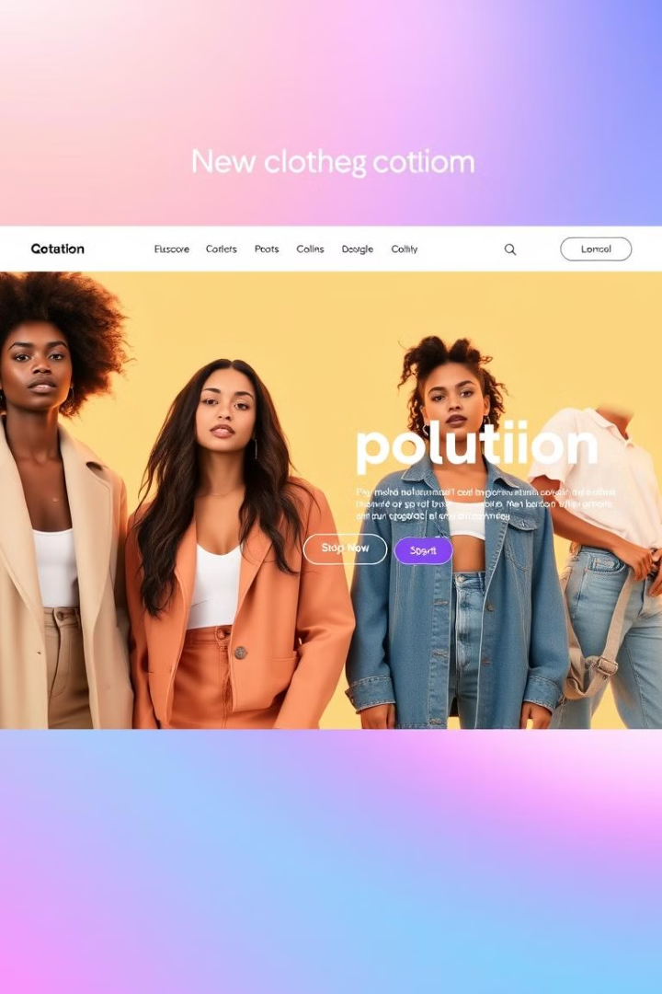

Sugandh: A New Fashion Experience
Name : Atul Rathour Roll no : 21
Branch : IT
Name : Romil Rupareliya Roll no : 23
Branch : IT
Name :Shivam Jayswal Roll no : 10
Branch : IT
Name :Sangna Limbasiya Roll no : 31
Branch : IT
Name :Vishwa Vaghela Roll no : 14
Branch : IT

Slide 2
Built with Powerful Technologies
React.js
Django
MongoDB Atlas
React.js provides a dynamic and interactive front-end experience for our website. Its component-based architecture allows for efficient code management and a seamless user interface.
Django serves as the robust backend framework, managing data storage, user authentication, and other essential server-side operations.
MongoDB Atlas is our choice for a scalable and flexible database solution. It allows us to store and manage vast amounts of product and user data efficiently.

Slide 3
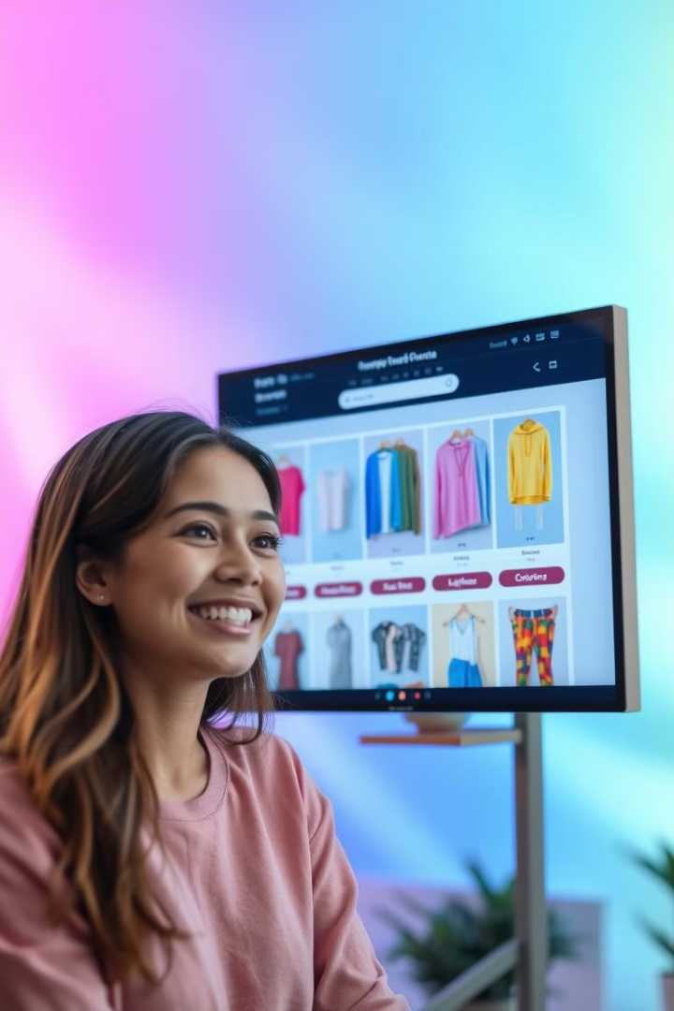
Explore the Perfect Outfit
1
Color Filtering
2
Size Selection
Easily filter your search by color to find the perfect shade for your style.
Choose your desired size from a comprehensive size range, ensuring a perfect fit.
3
Category Browsing
4
Advanced Search
Browse through different clothing categories like tops, bottoms, dresses, and more.
Utilize our powerful search bar to find specific items quickly.

Slide 4




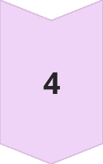
Convenient Shopping Cart
Add to Cart
Simply click the "Add to Cart" button on any product you want to purchase.
View Cart
Access your shopping cart at any time to review your items and modify quantities.
Wishlist
User can save their favorites in Wishlist
Wishlist-Add to cart
Easy Swap between wishlist to add to cart or vice-versa

Slide 5

Find Your Favorites
Look Book
Collections
Contact Us
Here we can view all the trending collections from the overall data.
Get all the collections made by us
Wanna collab with us? This page is for you

Slide 6
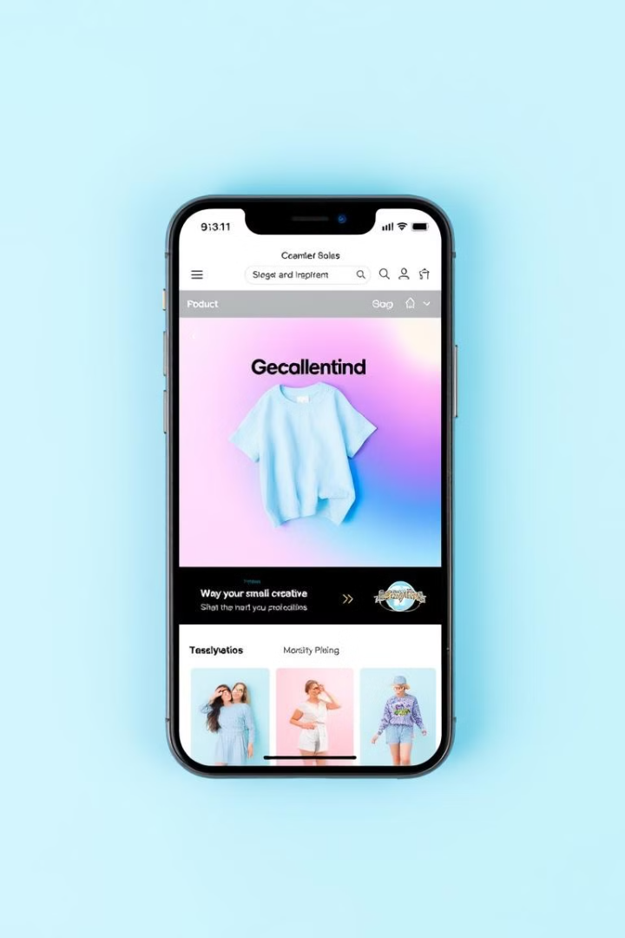
Backend and database connectivity
Desktop
Tablet
Mobile
Optimized for large screens
Adapts to smaller screen sizes
Provides a user-friendly experience on smartphones
Clear navigation and product details
Intuitive navigation with touch controls
Large buttons and clear text for easy touch interaction

Slide 7

Thank You!
Thank you for your interest in Sugandh. We hope you enjoy exploring our website and discovering the latest fashion trends.

